Slide 1
How to submit your java project for grading

Slide 2



Make sure that your program is running correctly and producing the output hat is required

Slide 3
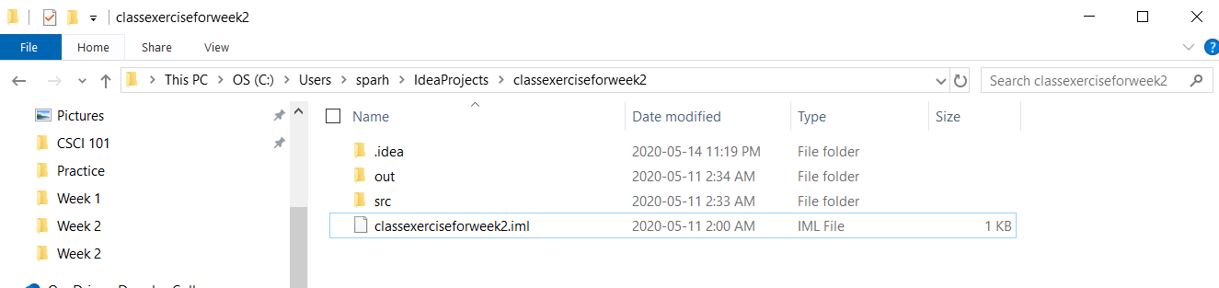
Look for your src files in your intellij project folder

Slide 4
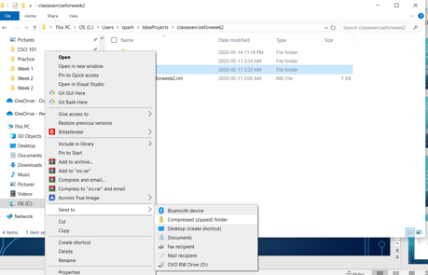
Zip your src folder based on the method below
Do not use any third party compressors

Slide 5
Submit the compressed src folder to your professor.

